Slide 1





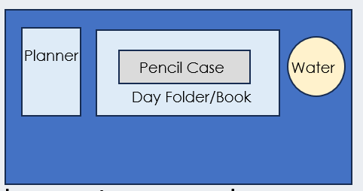






After the register, I am checking your….
Desk
Uniform
SLANT
All subject books go into your bag
(not floor or shelf!)
Notes:
This is you setting your expectation – issue demerits for uniform/equipment if they do not meet your expectation after this.

Slide 2







Read Now
Sunday 11 January 2026
Prior Knowledge Review
Task:
Complete the Read Now by:
Stick in the sheet.
Using a highlighter as you read to identify key terms.
Answer the first four recall questions under the sheet in your book.
Answer the stretch question
Aim High | Work Together | Be Kind | Lead the Way

Slide 3

Read Now
Answers:
B
Symbols
hydrogen (2 atoms), oxygen (1 atom)
Two
there is only one atom of that element
The formula NH₃ shows that the compound contains nitrogen and hydrogen, with 1 nitrogen atom and 3 hydrogen atoms.
Aim High | Work Together | Be Kind | Lead the Way

Slide 4
Daily Review
Follow your teachers instructions:
“When I say go show me a MWB and a MWB Pen”
You will have 10 seconds for each question.
Hold your MWB in the Ready position
“Show me”
You need to score 70% to pass
Subtitle ‘test score’ ?/10
Aim High | Work Together | Be Kind | Lead the Way
Notes:
Teachers remember to input the quiz score

Slide 5
MWB Quiz
1)What is the rate of change of velocity?
2) What is the term for slowing down (also known as negative acceleration)
3) What is the unit for acceleration?
4) What term describes something that is not moving?
5) What is the distance covered per unit time?

Slide 6
MWB Quiz
What is the rate of change of velocity? | Acceleration
What is the term for slowing down, also known as negative acceleration. | Deceleration
What is the unit for acceleration? | (m/s²)
What term describes something that is not moving? | Stationary
What is the distance covered per unit time? | Speed

Slide 7

Following this lesson, students will be able to:
Interpret chemical formulae
Describe the number and names of elements in a compound
Name compounds using standard rules
Key Words:
compound
subscript
acid
chemical formula
neutralisation
metal
Notes:
Can be edited depending on desired outcomes.

Slide 8
Key points to remember
1. Formulae can be used to show which elements are in compounds e.g. H₂O contains two hydrogen atoms and one oxygen atom. The ratio is 2:1.
2. Chemical reactions always involve the formation of one or more new substances.
3. Symbol equations can be used to show chemical reactions
e.g. 2H₂ + O₂ → 2H₂O
Notes:
Purpose: Revisiting some key prior learning that will be needed for this topic.
Note for teachers: The introduction slides in this lesson summarise some key topics that pupils may need to revisit prior to this unit. You should choose specific areas to focus on with your class, based on the outcomes of the pre-unit quiz.
Conservation of mass and balancing equations will be revisited later in this unit.
Suggested script:
Let’s review some key vocabulary from our study of chemistry so far. You will be using some of these words in the upcoming unit.
1. What is a formula? (Or formulae with an ‘AE’ at the end when I’m talking about more than one.)
Formulae can be used to show which elements are in a compound. For example, the formula H₂O, for water, tells us that water is made of the elements hydrogen and oxygen. The ratio is 2:1, which means that for every two hydrogens we have 1 oxygen atom.
If needed, add in some additional examples here to further explain the point, such as CO₂, HCl, CH₄.
2. Now, we have spoken a lot last year about chemical reactions. Remember, chemical reactions involve the formation of one or more new substances. That means, one or more new substances are made in every chemical reaction. Remember the reactants react with each other and they make something new.
You also learned the difference between a chemical change and a physical change. When a new substance is not created, that is a physical change, like when ice melts to make liquid water.
3. We have used lots of symbol equations last year to show what happens in a chemical reaction – here you can see an example of one of these. Remember on the left hand side we have reactants, on the right hand side we have products (these are made in the reaction), and in the middle we have an arrow (not an equals sign!) and this tells us that the reaction is happening.

Slide 9
What is a chemical formula?
Example 1: sodium sulfate.
Na₂SO₄
How many elements in this compound?
2. How many atoms of each type of element are there?
3. How many atoms are there in total are there in this compound?
Notes:
Exposition type: Explanation
Suggested script:
Lets remind ourselves what a chemical formula is. We’ll start with this one, Na₂SO₄. This is the formula for sodium sulfate.
Sodium sulphate is a salt and is a compound because there are two or more elements chemically joined together
If a compound name ends in –ate, then it usually contains three elements, including a non metal and an oxygen. So the same sodium sulfate already gives us a clue about what this compound might contain.
Let’s look at the elements within this compound
Ask students to use their periodic table to decide what elements are represented here.
Na – Na is sodium
S - is Sulphur
O- is oxygen
There are 2 atoms of sodium because there is a 2 subscript after the Na
There is 1 atom of sulphur because there is no subscript after the S but it is present
There are 4 atoms of oxygen because there is a 4 subscript after the O
The total number of atoms within the compound sodium sulphate is 7
How do I know that Na is one element, and it isn’t two elements with the symbols N and A? Because the chemical symbol has a capital N and a small a. If it were two different elements there would be two capital letters.
At this point, show students a molymod model of this compound so they can see what these numbers represent in ‘real’ terms. Point out the two sodium atoms, 1 sulfur and 4 oxygens.
If you go on to study A-level chemistry, you will learn to sketch the molecule shape once you know the chemical formula!
Image source: Fritzs / CC-BY-SA-3.0

Slide 10
What is a chemical formula?
Example 2: iron hydroxide.
Fe(OH)₃
How many elements in this compound?
2. How many atoms of each type of element are there?
3. How many atoms are there in total are there in this compound?
Notes:
Exposition type: Explanation
Suggested script:
Now lets look at this example. This is the formula for a substance called iron hydroxide.
How many elements are in this compound?
Fe is the symbol for the element iron
O is the symbol for the element oxygen
H is the symbol for the element hydrogen
..so we have three different elements represented in this formula.
How many atoms of each type of element are there?
There is 1 atom of iron (because there is no subscript number)
There are 3 atoms of oxygen – remember the number outside the brackets applies to all of the parts inside the brackets.
There are 3 atoms of hydrogen – because the number outside the brackets applies to all parts inside the brackets.
How many atoms in total are there in this compound?
Adding up 1 plus 3 plus 3 atoms, we see that there are 7 atoms in total within the compound iron hydroxide
At this point, show students a molymod model of this compound so they can see what these numbers represent in ‘real’ terms. Point out the 1 iron atom, 3 oxygen atoms and 3 hydrogen atoms.
Image source: Public domain, via Wikimedia Commons Hydroxid železnatý.PNG

Slide 11
What is a chemical formula?
Example 3: iron nitrate.
Fe(NO₃)₃
How many elements in this compound?
2. How many atoms of each type of element are there?
3. How many atoms are there in total are there in this compound?
Notes:
Exposition type: Explanation
Suggested script:
What is Fe the symbol for? iron
What is N the symbol for? nitrogen
What is O the symbol for? oxygen
So, how many elements are in this compound? 3
How many atoms of Fe are there? 1
How do you know? There are no numbers next to the Fe symbol, and that means there is only one of them.
There is a 3 outside of the brackets, what do we need to do with the number of atoms of nitrogen and oxygen inside the brackets? Multiply them by 3.
How many atoms of N? 3
Why? Because there is one Nitrogen inside the bracket, and the number three outside the brackets multiplies that by 3. 3 x 1 = 3.
How many atoms of O? 9
How do you know? There are three oxygens inside the brackets. There is a number 3 subscript outside the bracket, so this multiplies the atoms inside by 3. 3 x 3 = 9.
At this point, show students a molymod model of this compound so they can see what these numbers represent in ‘real’ terms. Point out the 1 iron atom, 3 nitrogen atoms and 9 oxygen atoms.
Stretch: Write, pair and share. Last year you completed the practical ‘making salts’ where you reacted an acid with a base to form a salt.
To form this compound (iron nitrate) I could use iron oxide as a base and react it with an acid. What acid would this be? Nitric acid.
Image source: Public domain, Alecjw at en.Wikipedia, https://upload.wikimedia.org/wikipedia/commons/5/5f/Ferric_nitrate_nonahydrate.jpg

Slide 12
Naming Compounds
Rule 1 – usually, the metal goes first and the non-metal goes second
Rule 2 – if a metal and a non-metal react, the name of the non-metal ends in –ide.
Rule 3 – for some compounds (where the elements are both non-metals), if there are a different number of atoms we add in ‘mono’ for 1, ‘di’ for 2 and ‘tri’ for 3
Rule 4 – if the compound names ends in –ate then it usually contains three elements, including a non-metal and oxygen
Notes:
Purpose: revisiting some key information that will be needed for this topic.
Some examples you may want to use:
Rule 1: e.g. iron and oxygen produce iron oxide
Rule 2: e.g oxygen produces oxide, sulfur produces sulfide, chlorine produces chloride
Rule 3: e.g. carbon monoxide, carbon trioxide. With rule 3 you may want to recap the meaning of a molecule at this point.
Rule 4: e.g. copper sulfate
Common Misconceptions with formulae and equations
(from RSC): https://edu.rsc.org/cpd/chemical-formulas-and-equations/3010001.article
All formulas as representing molecules, eg ‘NaCl means sodium chloride molecules.’
Not recognising polyatomic ions as a distinct chemical species, eg MgSO₄ named as magnesium sulfur tetroxide rather than magnesium sulfate.
Confusing polyatomic ions as elements, eg ’I can’t find hydroxide on the periodic table.’
Mixing up the symbol for an element, eg Cl, and its formula as a substance, eg Cl₂. This can be complicated by the use of the element symbol for giant structures – eg diamond as C and iron Fe – and some seemingly illogical exceptions, eg S₈ and P₄.
Mixing up the formula of a substance with the chemical equation of its production. For example giving ‘hydrogen + oxygen → water’ when asked for the formula of water. This misconception stems from maths where the two words are often used interchangeably and everyday life where the word formula is often associated with how something is made.
Students often struggle with the numerical relationships in equations and formulas, this can make the balancing of equation and chemical calculations difficult.

Slide 13


True or false?
Calcium (Ca) is an element.
Oxygen (O₂) is a compound.
Water boiling to form steam is a chemical reaction.
Compounds are made of one element.
NH₃ has a fixed ratio of one nitrogen atom to three hydrogen atoms.
CO₂ has a fixed ratio of 2 oxygen to 2 carbon atoms.
Al₂(SO₄)₃ contains 3 sulfur atoms.
Al₂(SO₄)₃ contains 4 oxygen atoms.
True
True False
False
False
False
True
False
True
False
Notes:
Purpose: to check that key knowledge from the introduce phase has been learnt and understood. Make sure you review the answers carefully. Especially 11 and 12.
Answers (animated)
1 True
2 False
3 False
4 False
5 True
6 False
7 True
8 False

Slide 14
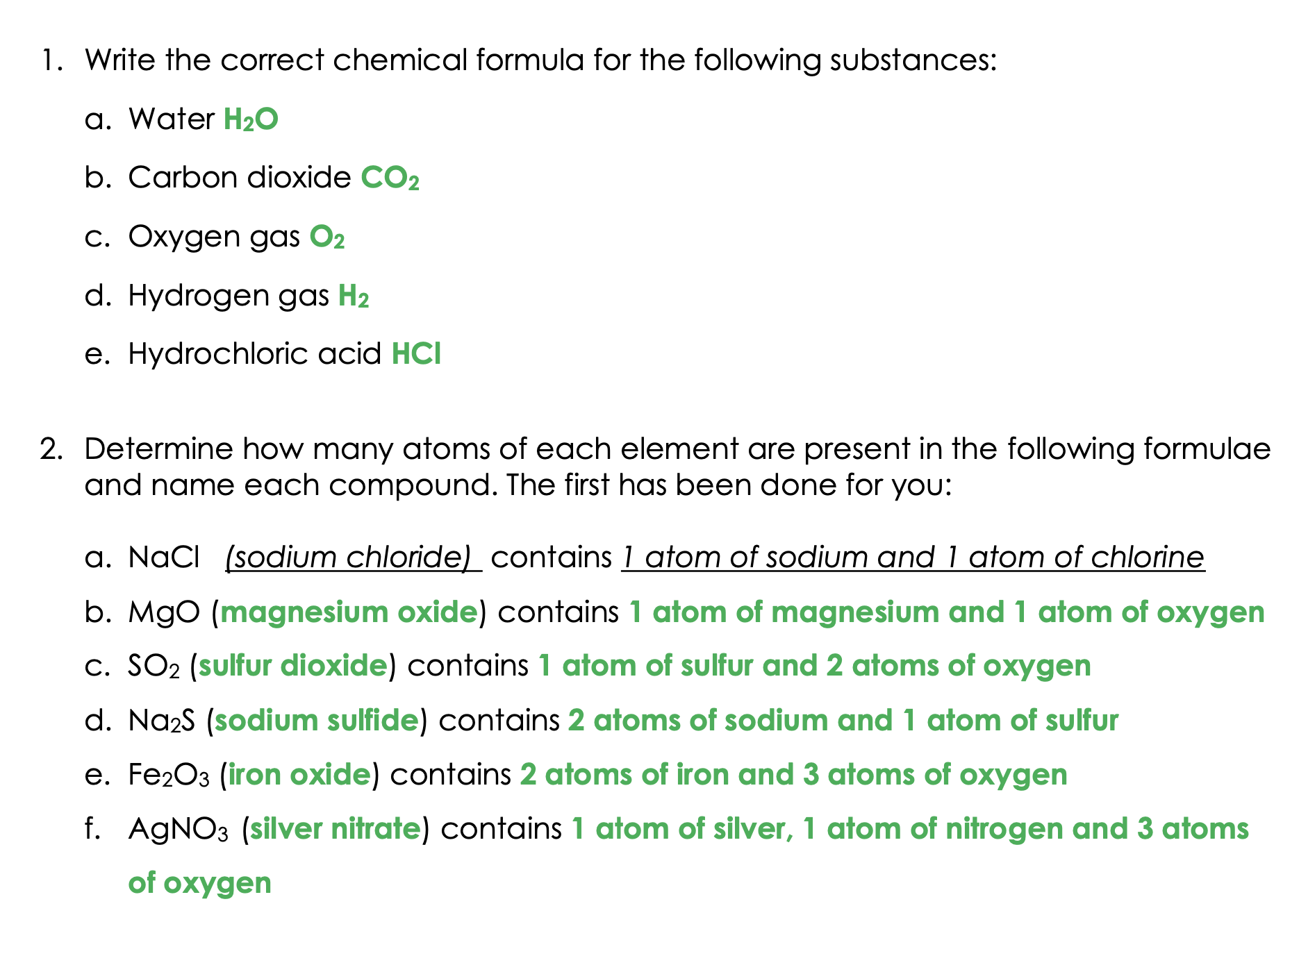

Slide 15
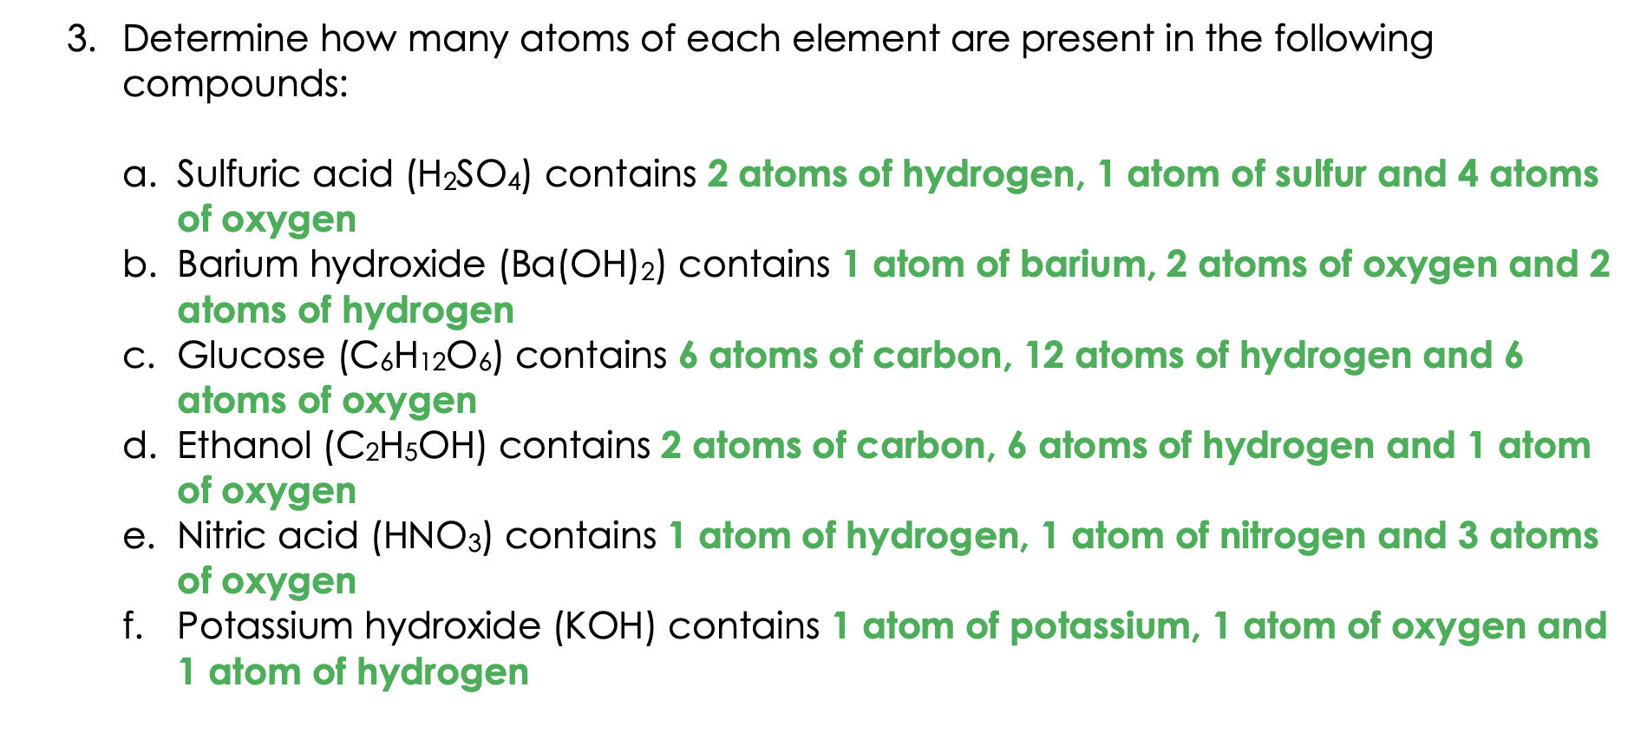

Slide 16
Answer the questions below.
Ammonia (NH₃) contains:
A. 3 nitrogen atoms and 1 hydrogen atom
B. 3 nitrogen atoms and 3 hydrogen atoms
C. 3 hydrogen atoms and 1 nitrogen atom
How many hydrogen atoms are in the formula (NH₄)₂SO₄ ?
A. 4
B. 8
C. 6
Copper carbonate reacted with hydrochloric acid. Which statement is correct?
A. Carbon dioxide is produced, and if it is bubbled through limewater it would turn cloudy/milky
B. Carbon dioxide is produced, and if it was bubbled through limewater it would remain clear
C. Carbon dioxide is not produced.
✓
✓
✓
Notes:
Q1. Answer: C.
If students get this question wrong they may be struggling with the meaning of the subscript in a chemical formulae. They may need more practice of determining the make up of formulae. To fix-it, give students a range of chemical formulae, for them to write the names and numbers of each element contained in them.
Q2. Answer: B.
If students answer A, they have misunderstood how the brackets are used in a chemical formula. If students answer C, they have incorrectly added the subscripts rather than multiplied. They may need more practice of determining complex chemical formulae. To fix-it, give students a range of chemical formulae which contain brackets, for them to write the names and numbers of each element contained in them.
Q3. Answer: A.
If students answer B, they have not understood the meaning of a positive limewater test. If students answer C, they do not know the correct products for this reaction, and may have mixed it up with the reaction between an acid and alkali. To fix-it, ask students to write the rules for general reactions of acids and to describe how to test for each of the gases, especially carbon dioxide.

